Slide 1
Single-Row Functions
Course Code: CSC 2108
Course Title: Introduction To Database
Department of Computer Science
Faculty of Science and Technology
Lecture No: | 06 | Semester:
Lecturer: | Nyme Ahmed [nyme.ahmed@aiub.edu]

Slide 2
Lecture Outline
SQL Functions
Types of SQL Functions
Single-Row Functions
Character Functions
Number Functions
Date Functions
Conversion Functions
TO_NUMBER
TO_CHAR
TO_DATE
General Functions
NVL Function
NVL2 Function
NULLIF Function
Decode Function

Slide 3
SQL Functions
Input
Function
Output
arg 1
Function performs action
arg 2
Result
value
arg n

Slide 4
Two Types of SQL Functions
Functions
Single-row
functions
Multiple-row
functions

Slide 5
Single-Row Functions
Manipulate data items
Accept arguments and return one value
Act on each row returned
Return one result per row
May modify the datatype
Can be nested
function_name (column|expression, [arg1, arg2,...])

Slide 6
Single-Row Functions
Character
General
Number
Single-row
functions
Conversion
Date

Slide 7
Character Functions
Character
functions
Case conversion
functions
Character manipulation
functions
LOWER
UPPER
INITCAP
CONCAT
SUBSTR
LENGTH
INSTR
LPAD, RPAD
Trim
Ltrim, Rtrim
Replace

Slide 8
Case Conversion Functions
Convert case for character strings
Function
Result
LOWER('SQL Course')
UPPER('SQL Course')
INITCAP('SQL Course')
sql course
SQL COURSE
Sql Course

Slide 9
Using Case Conversion Functions
Display the employee number, name, and department number for employee Blake.
SQL> SELECT empno, ename, deptno
2 FROM emp
3 WHERE ename = 'blake';
no rows selected
SQL> SELECT empno, ename, deptno
2 FROM emp
3 WHERE LOWER(ename) = 'blake';
EMPNO ENAME DEPTNO
--------- ---------- ---------
7698 BLAKE 30

Slide 10
Character Manipulation Functions
Manipulate character strings
Function
Result
CONCAT('Good', 'String')
SUBSTR('String',1,3)
LENGTH('String')
INSTR('String', 'r')
Trim(‘S’ from ‘SSMITH’)
Replace(‘toy’,’y’,’let’)
GoodString
Str
6
3
MITH
tolet

Slide 11
Using the Character Manipulation Functions
SQL> SELECT ename, CONCAT (ename, job), LENGTH(ename),
2 INSTR(ename, 'A')
3 FROM emp
4 WHERE
SUBSTR(job,1,5) = 'SALES';
ENAME CONCAT(ENAME,JOB) LENGTH(ENAME) INSTR(ENAME,'A')
---------- ------------------- ------------- ----------------
MARTIN MARTINSALESMAN 6 2
ALLEN ALLENSALESMAN 5 1
TURNER TURNERSALESMAN 6 0
WARD WARDSALESMAN 4 2

Slide 12
Number Functions
ROUND: Rounds value to specified decimal
ROUND(45.926, 2) 45.93
TRUNC: Truncates value to specified decimal
TRUNC(45.926, 2) 45.92
MOD: Returns remainder of division
MOD(1600, 300) 100

Slide 13
Using the ROUND Function
SQL> SELECT ROUND(45.923,2), ROUND(45.923,0),
2 ROUND(45.923,-1)
3 FROM DUAL;
ROUND(45.923,2) ROUND(45.923,0) ROUND(45.923,-1)
--------------- -------------- -----------------
45.92 46 50

Slide 14
Using the TRUNC Function
SQL> SELECT TRUNC(45.923,2), TRUNC(45.923),
2 TRUNC(45.923,-1)
3 FROM DUAL;
TRUNC(45.923,2) TRUNC(45.923) TRUNC(45.923,-1)
--------------- ------------- ---------------
45.92 45 40

Slide 15
Using the MOD Function
Calculate the remainder of the ratio of salary to commission for all employees whose job title is salesman.
SQL> SELECT ename, sal, comm, MOD(sal, comm)
2 FROM emp
3 WHERE job = 'SALESMAN';
ENAME SAL COMM MOD(SAL,COMM)
---------- --------- --------- -------------
MARTIN 1250 1400 1250
ALLEN 1600 300 100
TURNER 1500 0 1500
WARD 1250 500 250

Slide 16
Working with Dates
Oracle stores dates in an internal numeric format: century, year, month, day, hours, minutes, seconds.
The default date format is DD-MON-YY.
SYSDATE is a function returning date.
CURRENT_TIMESTAMP is a function returning date and time.
DUAL is a dummy table used to view SYSDATE, CURRENT_TIMESTAMP and other things.

Slide 17
Arithmetic with Dates
Add or subtract a number to or from a date for a resultant date value.
Subtract two dates to find the number of days between those dates.
Add hours to a date by dividing the number of hours by 24.

Slide 18
Using Arithmetic Operators with Dates
SQL> SELECT ename, (SYSDATE-hiredate)/7 WEEKS
2 FROM emp
3 WHERE deptno = 10;
ENAME WEEKS
---------- ---------
KING 830.93709
CLARK 853.93709
MILLER 821.36566

Slide 19
Date Functions
Function
Description
MONTHS_BETWEEN
Number of months between two dates
ADD_MONTHS
Add calendar months to date
NEXT_DAY
Next day of the date specified
LAST_DAY
Last day of the month
ROUND
Round date
TRUNC
Truncate date

Slide 20
Using Date Functions
MONTHS_BETWEEN ('01-SEP-95','11-JAN-94')
19.6774194
ADD_MONTHS ('11-JAN-94',6)
'11-JUL-94'
NEXT_DAY ('01-SEP-95','FRIDAY')
'08-SEP-95'
LAST_DAY('01-SEP-95')
'30-SEP-95'

Slide 21
Using Date Functions
Round(to_date(’25-jul-05’),’month’) => 01-Aug-05
Round(to_date(’25-may-05’),’month’) = > 01-JUN-05
Round(to_date(’25-jul-05’),’Year’) => 01-Jan-06
Round(to_date(’25-may-05’),’Year’) => 01-Jan-05
Trunc(to_date(’25-jul-05’),’month’) => 01-Jul-05
Trunc(to_date(’25-jul-05’),’year’) => 01-Jan-05

Slide 22
Conversion Functions
Datatype
conversion
Implicit datatype
conversion
Explicit datatype
conversion

Slide 23
Implicit Datatype Conversion
For assignments, the Oracle can automatically convert the following:
From
To
VARCHAR2 or CHAR
NUMBER
VARCHAR2 or CHAR
DATE
NUMBER
VARCHAR2
DATE
VARCHAR2

Slide 24
Implicit Datatype Conversion
For expression evaluation, the Oracle Server can automatically convert the following:
From
To
VARCHAR2 or CHAR
NUMBER
VARCHAR2 or CHAR
DATE

Slide 25
Explicit Datatype Conversion
TO_NUMBER
TO_DATE
NUMBER
CHARACTER
DATE
TO_CHAR
TO_CHAR

Slide 26
TO_CHAR Function with Dates
TO_CHAR(date, 'fmt')
The format model:
Must be enclosed in single quotation marks and is case sensitive
Can include any valid date format element
Has an fm element to remove padded blanks or suppress leading zeros
Is separated from the date value by a comma

Slide 27
Elements of Date Format Model
YYYY
Full year in numbers
YEAR
Year spelled out
MM
Two-digit value for month
MONTH
Full name of the month
MON
Three-letter abbreviation of the month
DY
Three-letter abbreviation of the day of the week
DD
Digit value for date
DAY
Full name of the day

Slide 28
Elements of Date Format Model
Time elements format the time portion of the date.
Add character strings by enclosing them in double quotation marks.
HH24:MI:SS AM
15:45:32 PM
DD "of" MONTH
12 of OCTOBER

Slide 29
Using TO_CHAR Function with Dates
SQL> SELECT ename,
2 TO_CHAR(hiredate, 'DD Month YYYY') HIREDATE
3 FROM emp;
ENAME HIREDATE
---------- -----------------
KING 17 November 1981
BLAKE 1 May 1981
CLARK 9 June 1981
JONES 2 April 1981
MARTIN 28 September 1981
ALLEN 20 February 1981
...
14 rows selected.

Slide 30
TO_CHAR Function with Numbers
TO_CHAR(number, 'fmt')
Use these formats with the TO_CHAR function to display a number value as a character:
9
Represents a number
0
Forces a zero to be displayed
$
Places a floating dollar sign
L
Uses the floating local currency symbol
.
Prints a decimal point
,
Prints a thousand indicator

Slide 31
Using TO_CHAR Function with Numbers
SQL> SELECT TO_CHAR(sal,'$99,999') SALARY
2 FROM emp
3 WHERE ename = 'SCOTT';
SALARY
--------
$3,000

Slide 32
TO_NUMBER and TO_DATE Functions
Convert a character string to a number format using the TO_NUMBER function
TO_NUMBER(char[, 'fmt'])
Convert a character string to a date format using the TO_DATE function
TO_DATE(char[, 'fmt'])

Slide 33
NVL Function
NVL = Null Value Logic
Converts null to an actual value
Replace the null value
Datatypes that can be used are date, character, and number.
Datatypes must match
NVL(comm,0)
NVL(hiredate,'01-JAN-97')
NVL(job,'No Job Yet')

Slide 34
Using the NVL Function
SQL> SELECT ename, sal, comm, (sal*12)+NVL(comm,0)
2 FROM emp;
ENAME SAL COMM (SAL*12)+NVL(COMM,0)
---------- --------- --------- --------------------
KING 5000 60000
BLAKE 2850 34200
CLARK 2450 29400
JONES 2975 35700
MARTIN 1250 1400 16400
ALLEN 1600 300 19500
...
14 rows selected.

Slide 35
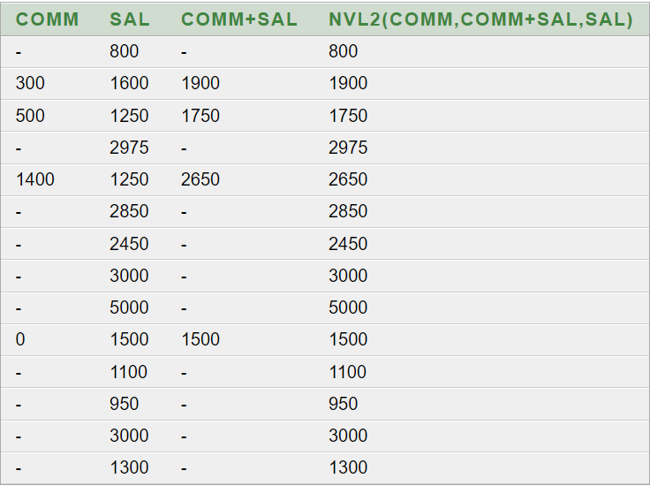
NVL2(expr1,expr2,expr3)
If exp1 is not null it returns exp2
If exp1 is null it returns exp3
else returns exp2
Example: Select comm, sal, comm+sal, nvl2(comm,comm+sal,sal) from emp

Slide 36
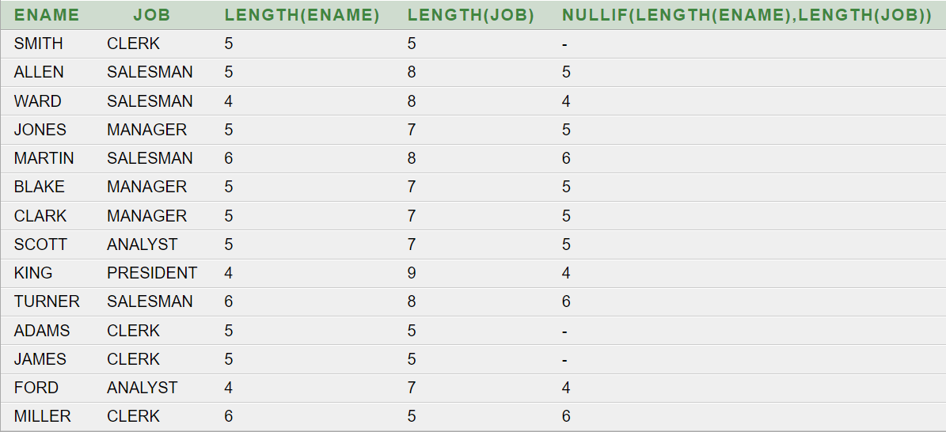
NULLIF(expr1,expr2)
Compares 2 expressions and
returns null if they are equal or the first expression if they are not equal.
Example:
Select ename, job, length(ename),length(job), NULLIF(length(ename),length(job)) from emp;

Slide 37
DECODE Function
Facilitates conditional inquiries by doing the work of a CASE or IF-THEN-ELSE statement
DECODE(col/expression, search1, result1
[, search2, result2,...,]
[, default])

Slide 38
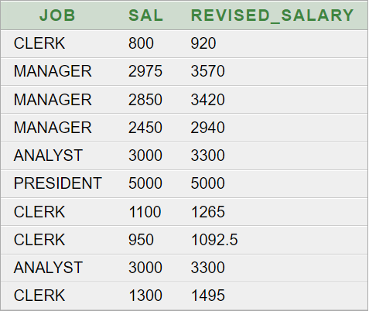
Using the DECODE Function
SELECT JOB, SAL,
DECODE(JOB, 'ANALYST', SAL*1.1,
‘CLERK', SAL*1.15,
'MANAGER', SAL*1.20,
'PRESIDENT', SAL) "REVISED_SALARY"
FROM EMP
WHERE JOB IN ('ANALYST', 'CLERK', 'MANAGER', 'PRESIDENT')

Slide 39
Nesting Functions
Single-row functions can be nested to any level.
Nested functions are evaluated from deepest level to the least-deep level.
F3(F2(F1(col,arg1),arg2),arg3)
Step 1 = Result 1
Step 2 = Result 2
Step 3 = Result 3

Slide 40
Nesting Functions
SQL> SELECT ename,
2 NVL(TO_CHAR(mgr),'No Manager')
3 FROM emp
4 WHERE mgr IS NULL;
ENAME NVL(TO_CHAR(MGR),'NOMANAGER')
---------- -----------------------------
KING No Manager

Slide 41
Books
Modern Database Management (Sixth Edition) by Fred R. McFadden, Jeffrey A. Hoffer, Mary B. Prescott
Database System Concepts (Fifth Edition) by Henry F. Korth, S. Sudarshan, A. Silberschatz
Oracle-database-10g-sql-fundamentals-1-student-guide-volume-1
SQL and Relational Theory: How to Write Accurate SQL Code by C.J. Date
Database Systems: A Practical Approach to Design, Implementation and Management (4th Edition) by Thomas M. Connolly, Carolyn E. Begg
Fundamentals of Database Systems, 5th Edition by RamezElmasri, Shamkant B. Navathe
Database Design and Relational Theory: Normal Forms and All That Jazz by C. J. Date
An Introduction to Database Systems 8th Edition, by C.J. Date

Slide 42
References
https://www.db-book.com/db6/slide-dir/index.html
https://docs.oracle.com/en/database/oracle/oracle-database/20/sqlrf/SQL-Standards.html#GUID-BCCCFF75-D2A4-43AD-8CAF-C3C97D92AC63
https://www.slideshare.net/HaaMeemMohiyuddin1/data-knowledge-and-information
https://www.slideshare.net/tabinhasan/from-data-to-wisdom
https://www.slideshare.net/thinnaphat.bo/

